Slide 1
Electricity
Chapter 20

Slide 2
GA Performance Standards
SPS10. Students will investigate the properties of electricity and magnetism.
SPS10. A. Investigate static electricity in terms of
  Friction
  Induction
  conduction
SPS10. B. Explain the flow of electrons in terms of
  Alternating and direct current
  The relationship among voltage, resistance, and current
  Simple series and parallel circuits
SPS10. C. Investigate applications of magnetism and/or its relationship to the movement of electrical change as it relates to
  Electromagnets
  Simple motors
  Permanent magnets

Slide 3
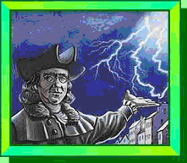
What is
Electricity?

Slide 4
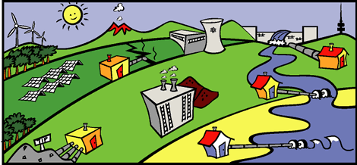
Electricity is the flow of electrical power or charge.
It is a secondary energy source which means that we get it from the conversion of other sources of energy, like coal, natural gas, oil, nuclear power and other natural sources, which are called primary sources.

Slide 5
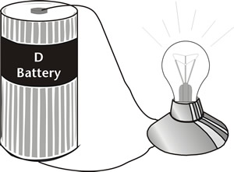
Electric Charge
Electrical energy is the energy associated with electric charges
Electric charge is a property that causes subatomic particles such as protons and electrons to attract or repel each other

Slide 6
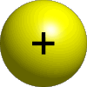


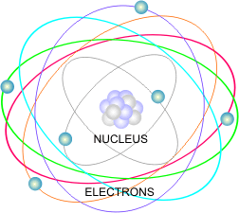
Atoms contain particles called protons, neutrons and electrons.
PROTON
ELECTRON
NEUTRON

Slide 7
Atoms basics
Protons have a positive charge and electrons have a negative charge
An atom has a cloud of negatively charged electrons surrounding the positively charged nucleus.
The atom is neutral sense it has equal numbers of protons and neutrons
An excess or shortage of electrons produces a net electric charge

Slide 8
In most atoms, the number of protons equals the number of electrons and the charges cancel each other out, and the atom has no net charge.
+ + + + +
- - - - -
Atoms become charged by gaining or losing electrons.
BEFORE AFTER
+-+-+-+- = (0) if it loses an electron +-+-+-+ = (+)
positive charge
+-+-+-+- = (0) if it gains an electron +-+-+-+- - = (-)
negative charge

Slide 9
Electric force
Electric force is the force of attraction or repulsion between electrically charged objects
electric force between two objects is proportional to the net charge on each object,
Electric force between two objects is inversely proportional to the square of the distance between them

Slide 10
Electric force
  Example: doubling the charge on one object doubles the electric force
  Example: doubling the distance between the objects the electric force is one fourth as strong
Inside an atom electric forces are stronger then gravitational force, but on large scale matter is mostly neutral and electric forces are close to zero.

Slide 11

Electrically charged
objects obey
the following rules:

Slide 12
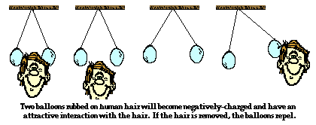
1. Law of conservation of charge:
Charge may be transferred from object to object, but it cannot be created nor destroyed

Slide 13
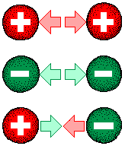
2. Like charges repel, and opposite charges attract.

Slide 14
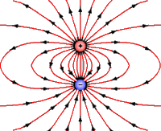
3. Surrounding every charge is an electric field.

Slide 15
Electric Field
Electric field is a field in a region of space that exerts electric forces on charged particles
the electric field is produce by electric charges or by changes magnetic fields
the strength of an electric field depends on the amount of charge that produces the field and on the distance from the field.
The more net charge an object has the greater is the force on it

Slide 16
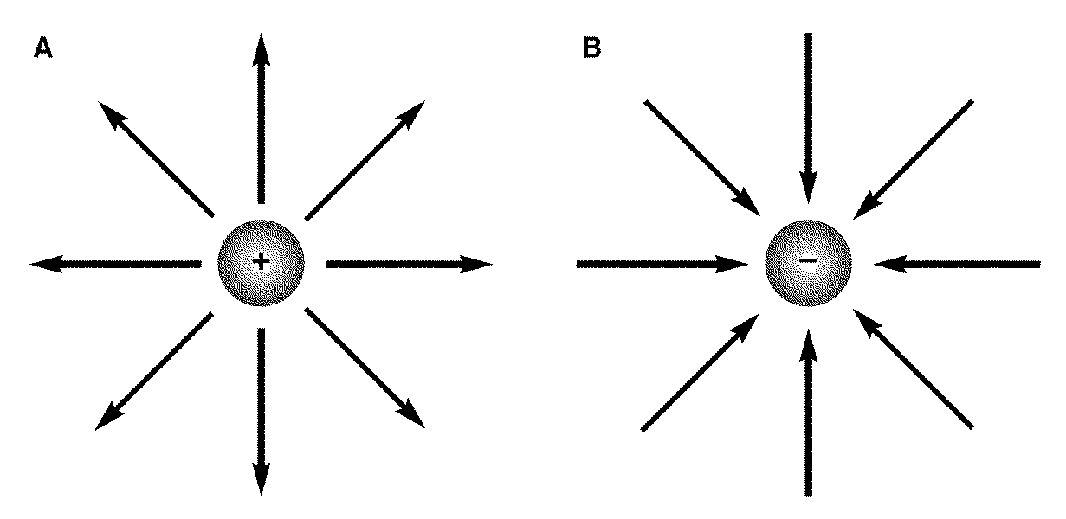
Electric field
Positive- Out Negative- In
+
-
Electric field depends on: distance and charge
The electric field around a positive charge points outward
The electric field around a negative charge points inward

Slide 17
4. Electrons move easily through conductors:
GOLD
SILVER
COPPER
METALS

Slide 18
5. Electrons do not move easily through insulators:
PLASTIC
WOOD
RUBBER
GLASS

Slide 19
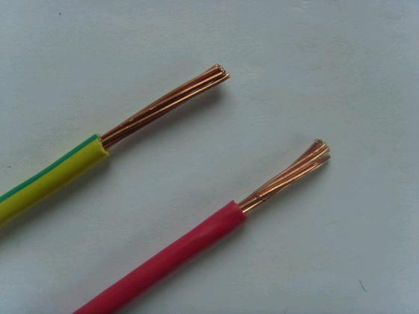
Which part of the material is the conductor?
Which part of the material is the Insulator?

Slide 20


Types of electricity
1. Static electricity is the study of the behavior of electric charges, including how charge is transferred between objects (in three ways).
Have you ever felt a shock when you touched an object after walking across a carpet? A stream of electrons jumped to you from that object. This is called static electricity.
Static Electricity Video

Slide 21
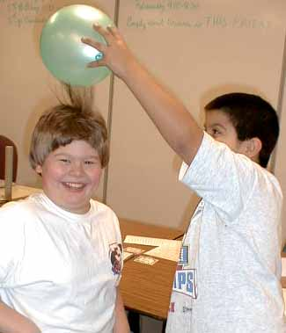
Transferring Electric Charge
charge transfer by friction (rubbing)
  Static electricity transferred by rubbing a balloon on the boy’s hair

Slide 22
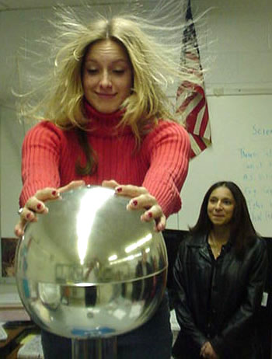
Transferring Electric Charge
2. Charge transfer by contact (direct contact)
Van de Graaff generator – machine that produces static electricity

Slide 23
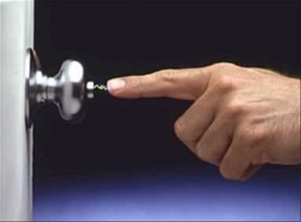
Transferring Electric Charge
charge transfer by induction (without contact)
  Shocking your hand on a doorknob before touching it
  Being struck by lightning b/c you are standing near a tree.

Slide 24

Types of electricity
2. Electric Current is a continuous flow of electrons.
example: wall outlet

Slide 25
Electric Current and Ohm’s Law

Slide 26


How do we use electricity?
We use electricity to do many jobs for us -- from lighting and heating/cooling our homes, to powering our televisions and computers.
Electricity is a controllable and convenient form of energy used in the applications of heat, light and power.

Slide 27

Why it’s important!!!!!
Without electric current, many devices would not exist, including telephones, personal computers, and lightning!

Slide 28
A. The flow of charges through a wire or conductor is called electric current.
Current is usually the flow of electrons.
Electric current is measured in amperes (A).
Charges flow from high voltage to low voltage.
a. Voltage difference- the push that causes charges to move, measured in volts (V).
4. For charges to flow, the wire must always be connected in a closed path, or circuit.

Slide 29
2 types of electric current (DC/AC)
Direct Current (DC)
Flow of electric charge in only one direction.
Flashlight and other battery operated devices use DC.
Alternating Current (AC)
Flow of electric charge that regularly reverses its direction.
Current in your homes, schools, and etc is AC

Slide 30
Electric Current (I)
AC= alternating current- reverses direction ex: current in schools and homes
DC= direct current- one direction ex: current in a battery
  Current travels easily through conductors.
  Current travels poorly through insulators.

Slide 31
Resistance
Resistance is the tendency for a material to oppose the flow of electrons, changing electrical energy into thermal energy and light.
All materials have some electrical resistance.
Resistance is measured in Ohms, Ω.
Making wires thinner, longer, or hotter increases the resistance.

Slide 32
Resistance (R)
Resistance is affected by:
Thickness (thin wires have more resistance than thick wires)
Temperature (increases as temperature increases)
Length (greater in longer wires than shorter wires)

Slide 33
20.2 Electric Current and Ohm’s Law
Insulators create resistance (opposition to the flow of charges in a material)
A material’s thickness, length, and temperature affects its resistance

Slide 34
Electric Current and Ohm’s Law
Remember, resistance is opposition to the flow of charges in a material
Is resistance greater or lesser in a longer wire?
  Greater- electrons travel farther
Is resistance greater or lesser in thinner wire?
  Greater- electrons collide less often
Is resistance greater or lesser in a hotter wire?
  Greater- electrons collide more often

Slide 35
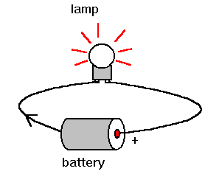
Electric Current and Ohm’s Law
In order for charge to flow in a conducting wire, the wire must be connected in a complete loop that includes a source of electrical energy

Slide 36
Voltage (V)
Potential difference-difference in electrical charges between 2 objects; also called voltage
Batteries supply voltage
Voltage sources include other devices like solar cells, and generators.

Slide 37
Ohm’s Law
The current in a circuit equals the voltage difference divided by the resistance:
Current = (I) is measured in amperes.
Voltage difference = (V) is measured in volts.
Resistance = (R) is measured in ohms.
Current = voltage difference or I = V
resistance R

Slide 38
Practice Example
What is the resistance if the voltage is 3 volts and the current is 9 amps?

Slide 39
Practice Example
What is the voltage is the resistance is 12 ohms and the current is 4 amps?

Slide 40
Practice Example
What is the current if the voltage is 14 volts and the resistance is 7 ohms?

Slide 41
Electrical Charge

Slide 42
Why It’s Important!
The convenience and safety of household electricity depend on how the electric circuits in your home are designed.

Slide 43
Electrical Energy
Circuits rely on generators at power plants to produce a voltage difference across the outlet, causing the charge to move when the circuit is complete.
Two Types of Circuits:
1. Series Circuits
2. Parallel Circuits

Slide 44
Series / Parallel Circuits
Series circuit- the current has only one loop
wired one after another, so the amount of current is the same throughout every part.
Open circuit- if any part of a series is disconnected, no current flows through the circuit.
Example: strings of holiday lights.
2. Parallel circuit- contains two or more branches for current to move through.
a. Individual parts can be turned off without affecting the entire circuit.
b. Example: the electrical system in a house.

Slide 45
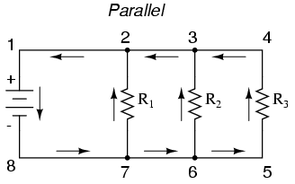
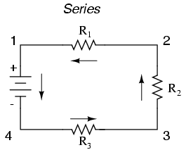
Series and Parallel Circuits
Series Circuit
Parallel Circuit

Slide 46
Electrical Energy
Household circuits use parallel circuits connected in a logical network.
1. Each branch receives the standard voltage difference from the electric company.
2. Electrical energy enters your home at the circuit breaker or fuse box and branches out to wall sockets, major appliances, and lights.

Slide 47
Guards against overheating electric wires.
Electric fuse contains a small piece of metal that melts if the current becomes too high, opening the circuit and stopping the flow of current.
Circuit breaker contains a small piece of metal that bends when it gets hot, opening the circuit and stopping the flow of current.

